Slide 1
Incorporating Neuropsychological Tests into Experimental Research
Simritpal K. Malhi
malhi11@uwindsor.ca
July 28, 2020

Slide 2
Outline
Purpose of neuropsychological tests
Cognitive domains and examples of tests
Ethical and legal considerations
Future research

Slide 3
Disclaimer
Examples of tests
Examples are North American and in English
Adult tests

Slide 4
Purpose of Neuropsychological Tests
Standard purpose: clinical assessment
Modified purpose for research: how a certain cognitive variable (i.e., individual difference) may influence performance on a task of interest
E.g., does a higher working memory performance result in shorter LDTs for concrete and imageable vs. abstract and non-imageable words?
But, many neuropsychological tests are scored as impaired/not impaired so not useful for individual differences – undergraduate sample will fall within normal limits
Look for tests with a high ceiling
Benefit
Norms (age & education)
Notes:
-age – older vs. younger adult processing speed
-education – learning difficulties vs. higher education

Slide 5
Estimated Intelligence/Ability Level
For those with no impairment in language, typically based off of a combination of:
Education level
Word reading test
E.g., Test of Premorbid Functioning (TOPF) – also gives you an estimate of IQ based on the reading score

Slide 6
Language
Fused Dichotic Words Test – dominance of left or right hemisphere for language
Verbal fluency test (lexical & categorical)
Likely for clinical population:
Auditory comprehension (questions or commands)
Visual (Boston naming test) vs. auditory (Columbia naming test) confrontation naming
Sentence repetition test
Examiner: The neuropsychologist was worried about having technical difficulties during her Zoom presentation today.
Participant: The neuropsychologist was very (addition) worried about having (omission) technical difficulties difficulty (syntactic paraphasia) during her Zoom Skype (semantic paraphasia) presentation today.
Collaborate with a speech-language pathologist

Slide 7
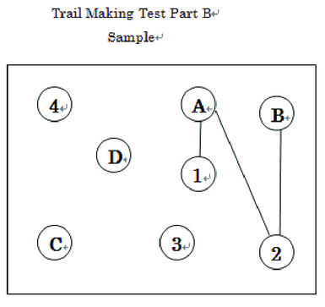
Attention
Auditory vs. visual
Immediate (i.e., attention span) – in the moment
E.g., digits forward
Sustained – over time
Alternating – switching
E.g., Trail Making Test Part B
Divided – multitasking
Working memory – manipulating information
E.g., digits backward and sequencing
2 – 6 – 8 – 9 – 5 – 1 – 3
3 – 1 – 5 – 9 – 8 – 6 – 2

Slide 8
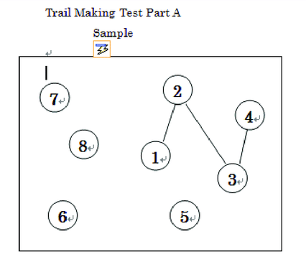
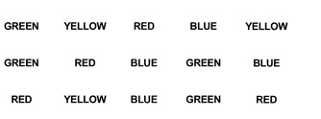
Processing Speed
Verbal – e.g., Stroop Naming
Visual/motor – e.g., Trail Making Test Part A

Slide 9
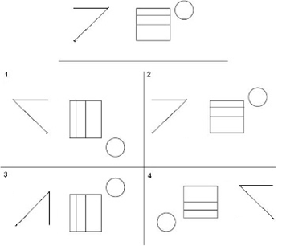
Memory
Verbal (e.g., word list) vs. visual (e.g., shapes)
Short vs. long delay
Recall vs. recognition
Qualitative performance
Intrusions
Repetitions
Primacy vs. recency effect
Strategy use (e.g., semantic clustering)
Need to consider delay – how long is your study? What is going to be in the delay?

Slide 10
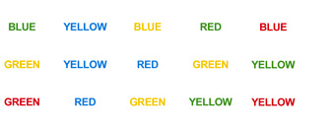
Executive Functioning
Planning/organizing
Decision making
Judgment
Problem solving
Response inhibition
Notes:
-name the colour

Slide 11
Emotion and Personality
Questionnaires
Again, typically used to aid diagnosis
Most will fall within normal limits
Emotion – state vs. trait anxiety
Personality – e.g., big five with NEO

Slide 12
Tips for Testing
Standardization is critical – no paraphrasing
Otherwise norms voided
Assess for substance use on the day of testing

Slide 13
Norms
If doing more than one test, aim to use it from the same battery so that the norms are consistent, e.g., Neuropsychological Assessment Battery
Published norms in the literature (e.g., “MOANS” for older adults)
Heaton norms

Slide 14
Ethical Considerations
Competence in administering, scoring, and interpreting the tests
Feedback?
Balancing research and clinical needs – if participant goes on to have a medical condition that requires a neuropsychological evaluation (e.g., stroke)
You now have baseline data – is it going to be available to the neuropsychologist seeing them?
Practise effects
Consider alternate forms or older versions of tests
DIY neuropsychological tests
Psychometric properties?

Slide 15
Legal Considerations
May vary depending on location so verify requirements (e.g., with your College of Psychologists)
Competence
Credentials required for purchasing and administering tests
Consider collaboration
Test security/copyright
No photocopying or scanning/distributing electronically
Do not include sample items in publication
Look into requirements for medical vs. research record

Slide 16
Future Research
Management of big data (i.e., neuropsychology norms)
E.g., looking up the imageability rating, frequency, and age of acquisition of a concrete word
What about looking up how 80-year-old African American males with 16 years of education with a left hemisphere stroke perform on Trails B in seconds?
Databases for norms

Slide 17
Thank you!
Please feel free to email (malhi11@uwindsor.ca) me with any questions or comments. I would be happy to consult/collaborate ☺

Slide 18
Q & A
Could you speak more about the fused dichotic words test and how it would be used and how can it be accessed?
https://www.uvic.ca/socialsciences/psychology/research/clinic/dichotic.php
http://www.dichoticlistening.com/index.html
Do you have recommendations regarding screening for substance use on the day of testing?
Build questions about substance use into other questions about their day so participants feel comfortable sharing; consider indirect reporting (i.e., written response) rather than a verbal response.
It seems that the act of translating what someone has in their visual memory into a recall response complicates things, making it difficult to verify that their response genuinely reflects what they are holding in visual memory.
Recall tests may not be appropriate for those with: i) motor difficulties or for those with ii) executive dysfunction if visual stimuli are complex. You could use simple visual stimuli (e.g., simple shapes) if this is a concern or use a visual memory test that does not rely on reproduction, just recognition.

Slide 19
Q & A
Do you have experience with administering neuropsychological testing online?
https://iopc.online/teleneuropsychology
How do these tests take into consideration individual diverse language backgrounds? Are there neuropsychological tests that are more accessible/available across languages?
Language-free tests are your best bet for diverse language backgrounds, e.g., Test of Nonverbal Intelligence (TONI).
Do you have a recommendation for a short test that could be used without taking over a whole experiment (e.g., 10 minutes) that looks at overall cognitive ability?
Consider getting to know the participant, e.g., are they an A student vs. C student. Otherwise for overall cognitive ability see slide 5.

Slide 20
Q & A
People often use digits forward as a test of Working Memory, which is incorrect. Could you speak to the benefit of using a combination of digit span tasks as a measure of various cognitive abilities?
Digits forward is a test of immediate auditory attention span. Digits backward and sequencing are tests of working memory. You could combine all three for an overall attention measure but still it would be better to look at them individually.
What is your opinion on the Modern Language Aptitude Test?
Looks interesting but I have not used it.
What is the best way to present tests to vulnerable populations?
Carefully review risks and benefits so that there is no falsely perceived benefit.

Slide 21
Q & A
Is there a way to compare older versions of tests with current versions?
Test manual and publisher website will describe the differences.
If you are developing your own survey, is there any type of question that should generally be avoided in the context of ethics (e.g., emotional state questions)?
Questions regarding suicidal ideation unless you have the necessary clinical skills to follow up.
What kinds of tests do you know of that have been used with EEG?
I am not experienced in the literature on neuropsychological tests and EEG.

